Slide 1
Inheritance

Slide 2
Inheritance
Inheritance is the ability of one class to inherit the properties of another class. A new class can be created from an existing class. The existing class is called BASE CLASS or SUPER CLASS and the new class is called DERIVED CLASS or SUB CLASS.
Example:
Car inherits from another class auto_mobile
Computer_student inherits from another class student

Slide 3
Arrange concepts into an inheritance hierarchy
Concepts at higher levels are more general
Concepts at lower levels are more specific (inherit properties of concepts at higher levels)
Vehicle
Wheeled vehicle
Boat
Car
Bicycle
2-door
4-door

Slide 4
Advantages of inheritance
When a class inherits from another class, there are three benefits:
(1) You can reuse the methods and data of the existing class
(2) You can extend the existing class by adding new data and new methods
(3) You can modify the existing class by overloading its methods with your own implementations

Slide 5
Inheritance is the property that allows the reuse of an existing class to build a new class
Base Class
Derived class
Methods and Properties
Base class methods + Additional methods

Slide 6
General Syntax for Inheritance
class <derived classname > : access-specifier <base classname >
{
---
----
};

Slide 7
Access specifier
Public - The members declared as Public are accessible from outside the Class through an object of the class.
Protected - The members declared as Protected are accessible from outside the class BUT only in a class derived from it.
Private - These members are only accessible from within the class. No outside Access is allowed.

Slide 8
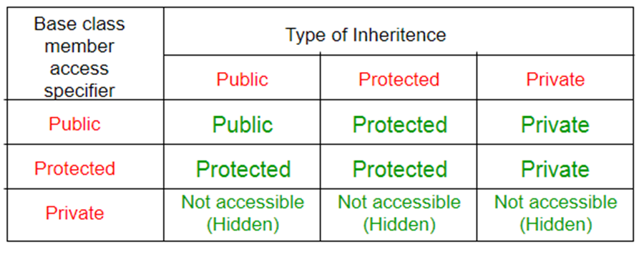
Accessibility of base class member

Slide 9
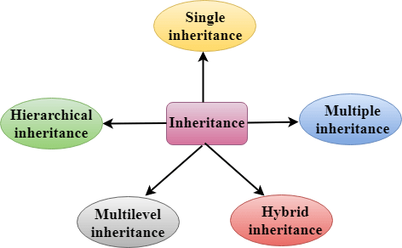
Types of Inheritance

Slide 10
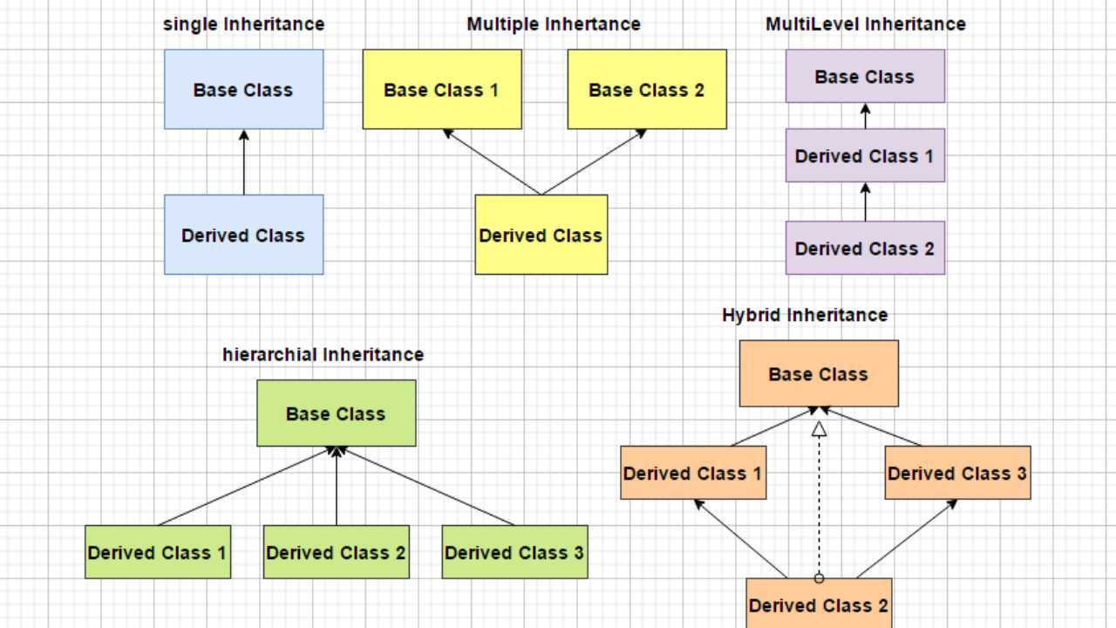
Types Of Inheritance

Slide 11
Single Inheritance
A class can be derived from a single base class is called single inheritance
Person
Employee

Slide 12
class Parent
{
public:
int id_p;
};
// Sub class inheriting from Base Class(Parent)
class Child : public Parent
{
public:
int id_c;
};
int main()
{
Child obj1;
// An object of class child has all data members
// and member functions of class parent
obj1.id_c = 7;
obj1.id_p = 91;
cout << "Child id is: " << obj1.id_c << '\n';
cout << "Parent id is: " << obj1.id_p << '\n';
return 0;
}
Output :
Child id is 7
Parent id is 91

Slide 13
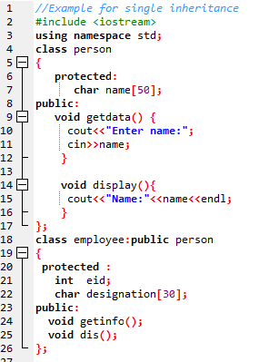
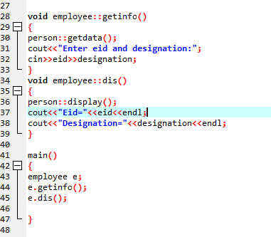

Slide 14
Multilevel Inheritance
A class be can derived from a derived class which is known as multilevel inheritance.
Person
Vehicle
Car
Employee
Racing car
Part time Employee

Slide 15
// C++ program to implement
// Multilevel Inheritance
#include<iostream>
using namespace std;
// base class
class Vehicle
{
public:
Vehicle()
{
cout << "This is a Vehicle\n";
}
};
// first sub_class derived from class vehicle
class fourWheeler: public Vehicle
{ public:
fourWheeler()
{
cout << "Objects with 4 wheels are vehicles\n";
}
};
// sub class derived from the derived base class fourWheeler
class Car: public fourWheeler {
public:
Car()
{
cout << "Car has 4 Wheels\n";
}
};
// main function
int main()
{
// Creating object of sub class will
// invoke the constructor of base classes.
Car obj;
return 0;
}
Output
This is a Vehicle
Objects with 4 wheels are vehicles
Car has 4 Wheels

Slide 16
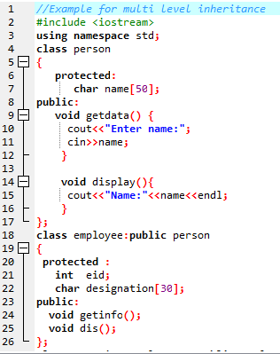
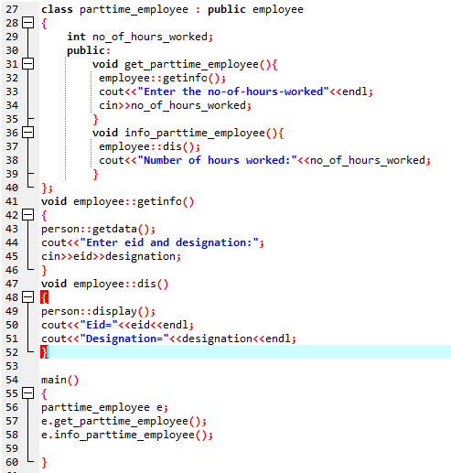

Slide 17
Multiple Inheritance
It is the process of creating new class from more than one base classes.
Syntax :
class <derived class >:<access specifier>
base_class1,<access specifier> base_class2...
{
private :
// members;
protected :
// members;
public :
//memebers;
};
Person
Employee
Teacher

Slide 18
// C++ program to explain
// multiple inheritance
#include<iostream>
using namespace std;
// first base class
class Vehicle {
public:
Vehicle()
{
cout << "This is a Vehicle\n";
}
};
// second base class
class FourWheeler {
public:
FourWheeler()
{
cout << "This is a 4 wheeler Vehicle\n";
}
};
// sub class derived from two base classes
class Car : public Vehicle, public FourWheeler
{
};
// main function
int main()
{
// Creating object of sub class will
// invoke the constructor of base classes.
Car obj;
return 0;
}
Output
This is a Vehicle
This is a 4 wheeler Vehicle

Slide 19
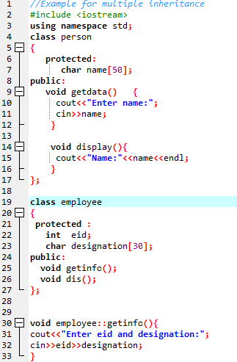
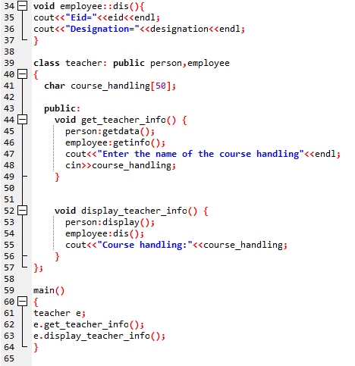

Slide 20
Hierarchical Inheritance
If more than one class is inherited from a base class, it's known as hierarchical inheritance. In general, all features that are common in child classes are included in base class in hierarchical inheritance.
Employee
Permanent Employee
Temporary Employee

Slide 21
class base_class
{
//data members
//member functions
};
class derived_class1 : visibility_mode base_class
{
//data members
//member functions
};
class derived_class2 : visibility_mode base_class
{
//data members
//member functions
};

Slide 22
// second sub class
class Bus: public Vehicle
{
};
// main function
int main()
{
// Creating object of sub class will
// invoke the constructor of base class.
Car obj1;
Bus obj2;
return 0;
}
// base class
class Vehicle
{
public:
Vehicle()
{
cout << "This is a Vehicle\n";
}
};
// first sub class
class Car: public Vehicle
{
};
Output
This is a Vehicle
This is a Vehicle

Slide 23
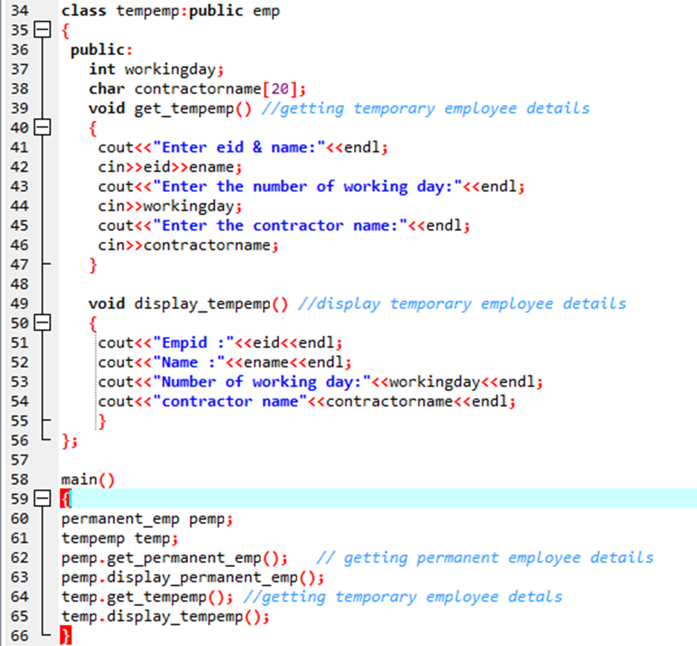
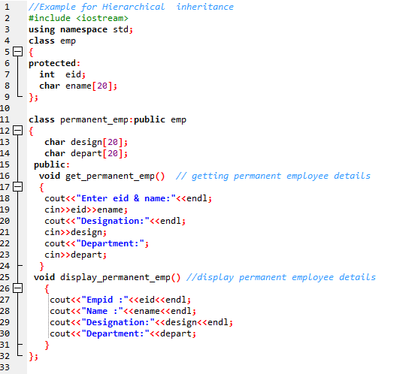

Slide 24
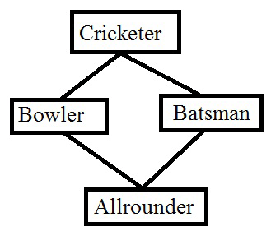
Hybrid Inheritance
Hybrid is nothing but the combination of Multilevel and multiple Inheritance

Slide 25
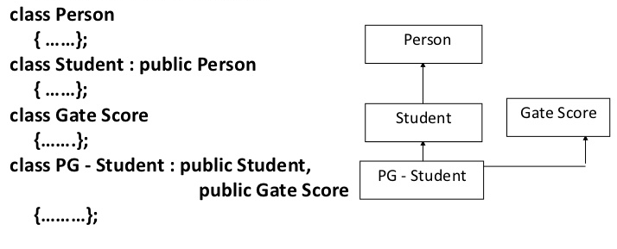

Slide 26
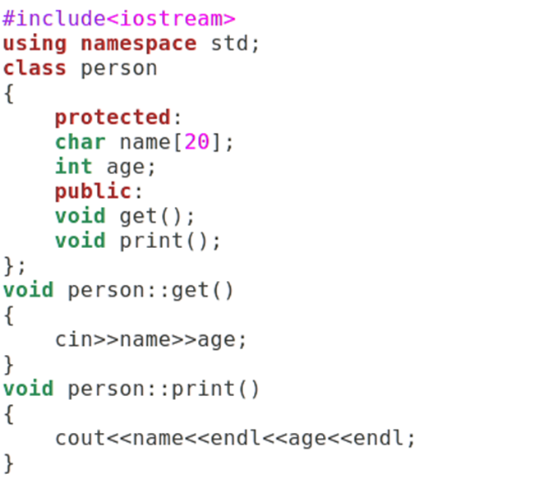
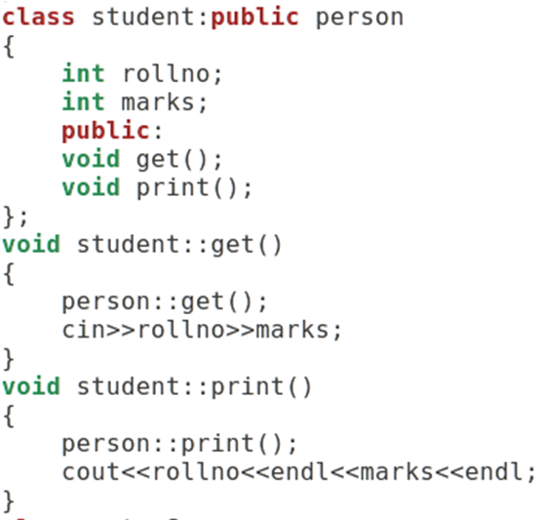

Slide 27
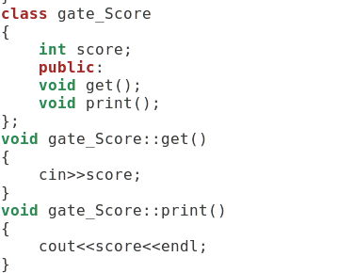
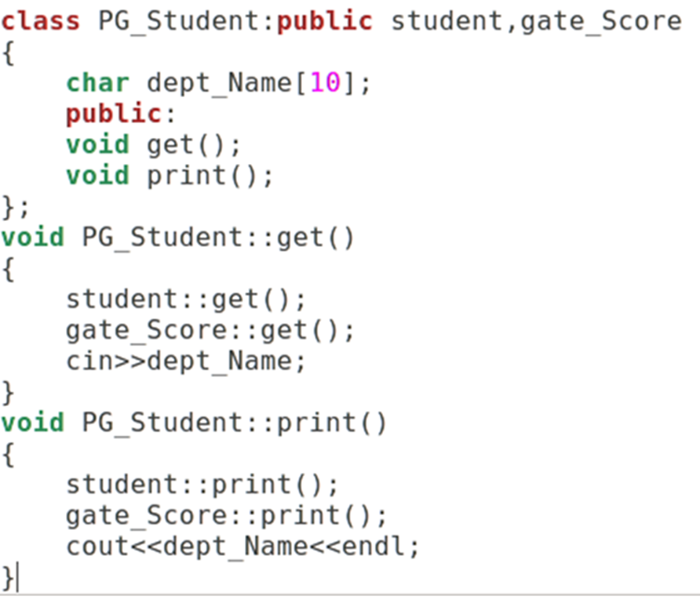
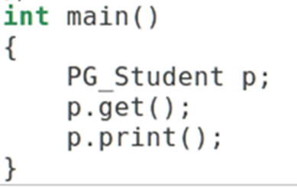

Slide 28
#include<iostream>
class ClassA {
public:
int a;
};
class ClassB : public ClassA {
public:
int b;
};
class ClassC : public ClassA {
public:
int c;
};
class ClassD : public ClassB, public ClassC
{
public:
int d;
};
MULTIPATH Inheritance
int main()
{
ClassD obj;
// obj.a = 10; // Statement 1, Error [ambiguous]
// obj.a = 100; // Statement 2, Error [ambiguous]
obj.ClassB::a = 10; // Statement 3
obj.ClassC::a = 100; // Statement 4
obj.b = 20;
obj.c = 30;
obj.d = 40; Output:
cout << " a from ClassB : " << obj.ClassB::a;
cout << "\n a from ClassC : " << obj.ClassC::a;
cout << "\n b : " << obj.b;
cout << "\n c : " << obj.c;
cout << "\n d : " << obj.d << '\n';
}
OUTPUT
a from ClassB : 10
a from ClassC : 100
b : 20
c : 30
d : 40

Slide 29
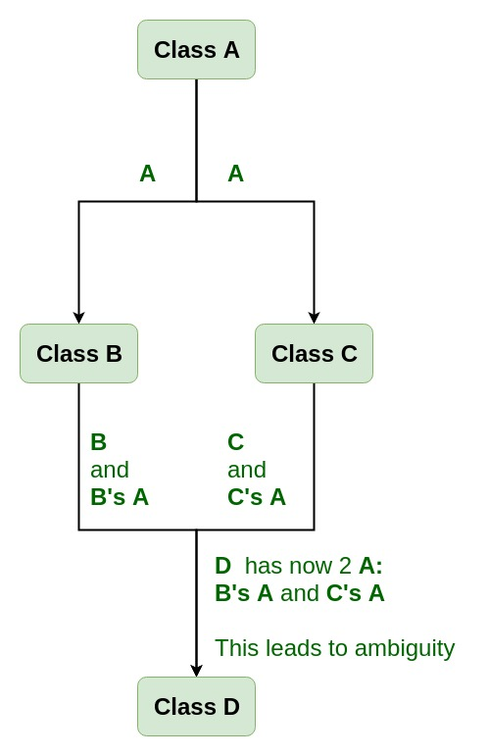
VIRTUAL BASE CLASS
As we can see from the figure that data members/function of class A are inherited twice to class D. One through class B and second through class C. When any data / function member of class A is accessed by an object of class D, ambiguity arises as to which data/function member would be called? One inherited through B or the other inherited through C. This confuses compiler and it displays error.
Syntax for Virtual Base Classes:
Syntax 1:
class B : virtual public A
{
};
Syntax 2:
class C : public virtual A
{
};

Slide 30
using namespace std;
class A {
public:
int a;
A() // constructor
{
a = 10;
}
};
class B : public virtual A
{
};
class C : public virtual A
{
};
class D : public B, public C
{
};
int main()
{
D object; // object creation of class d
cout << "a = " << object.a << endl;
return 0;
}
NOTE :
virtual can be written before or after the public. Now only one copy of data/function member will be copied to class C and class B and class A becomes the virtual base class.
Virtual base classes offer a way to save space and avoid ambiguities in class hierarchies that use multiple inheritances. When a base class is specified as a virtual base, it can act as an indirect base more than once without duplication of its data members. A single copy of its data members is shared by all the base classes that use virtual base.

Slide 31
#include <iostream>
using namespace std;
class A {
public:
void show()
{
cout << "Hello from A \n";
}
};
class B : public virtual A {
};
class C : public virtual A {
};
class D : public B, public C {
};
int main()
{
D object;
object.show();
}
Output:
Hello from A

Slide 32
Same Data Member Name in Base and Derived Class
#include<iostream>
using namespace std;
class A
{
protected:
int x;
public:
A(){x=5;}
void print()
{
cout<<"inside A"<<endl;}
};
class B:public A
{
int x;
public:
B(){x=10;}
void print()
{
cout<<"inside B"<<endl;
cout<<x<<endl;
}
};
main()
{
B b;
A a;
a.print();
b.print();
}

Slide 33
Order of Constructor Call
Base class constructors are always called in the derived class constructors. Whenever you create derived class object, first the base class default constructor is executed and then the derived class's constructor finishes execution.
Points to Remember
Whether derived class's default constructor is called or parameterised is called, base class's default constructor is always called inside them.
To call base class's parameterised constructor inside derived class's parameterised constructor, we must mention it explicitly while declaring derived class's parameterized constructor.

Slide 34
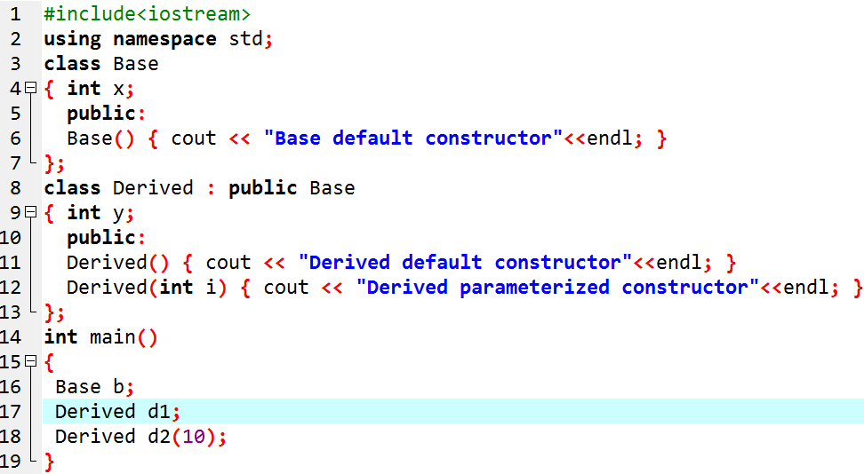
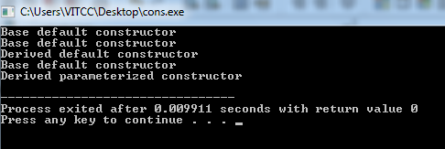

Slide 35
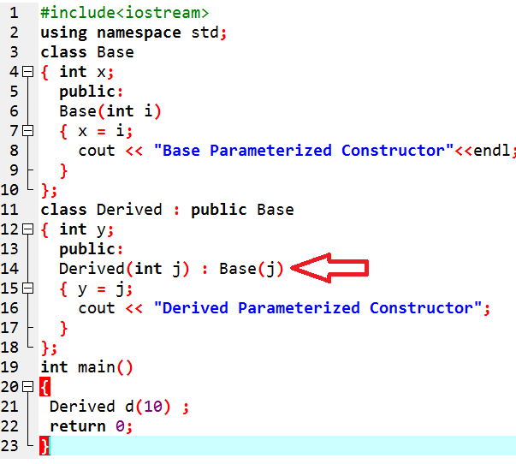
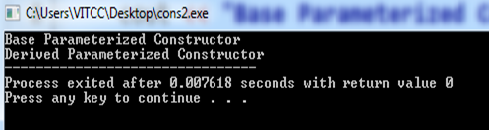
Base class Parameterized Constructor in Derived class Constructor
We can explicitly mention to call the Base class's parameterized constructor when Derived class's parameterized constructor is called.

Slide 36
Constructor call in Multiple Inheritance
Its almost the same, all the Base class's constructors are called inside derived class's constructor, in the same order in which they are inherited.
class A : public B, public C ;
In this case, first class B constructor will be called, then class C constructor and then class A constructor.

Slide 37
3 Types of Access Specifiers
Type 1: inherit as private
Base | Derived
private members | inaccessible
protected members | private members
public members | private members

Slide 38
3 Types of Access Specifiers
Type 2: inherit as protected
Base | Derived
private members | inaccessible
protected members | protected members
public members | protected members

Slide 39
3 Types of Access Specifiers
Type 3: inherit as public
Base | Derived
private members | inaccessible
protected members | protected members
public members | public members

Slide 40
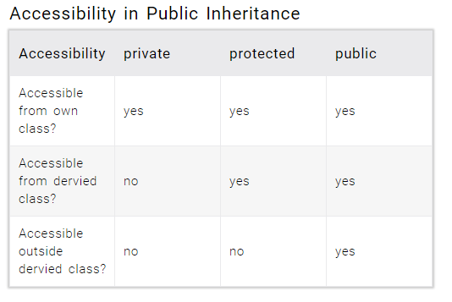

Slide 41
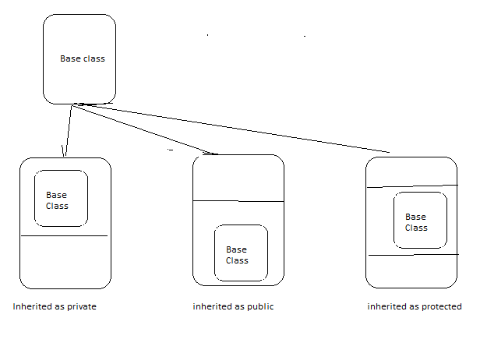

Slide 42
Public Inheritance:
All Public members of the Base Class become Public Members of the derived class & All Protected members of the Base Class become Protected Members of the Derived Class.
class Base {
public: int a;
protected: int b;
private: int c;
};
class Derived:public Base {
void doSomething() {
a = 10; //Allowed
b = 20; //Allowed
c = 30; //Not Allowed, Compiler Error
}
};
int main() {
Derived obj;
obj.a = 10; //Allowed
obj.b = 20; //Not Allowed, Compiler Error
obj.c = 30; //Not Allowed, Compiler Error
}

Slide 43
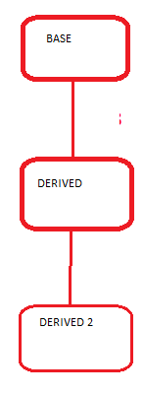
Private Inheritance:
All Public members of the Base Class become Private Members of the Derived class & All Protected members of the Base Class become Private Members of the Derived Class.
Class Base {
public: int a;
protected: int b;
private: int c; };
class Derived:private Base //defaults access specifier is private {
void doSomething() {
a = 10; //Allowed
b = 20; //Allowed
c = 30; //Not Allowed, Compiler Error }
};
class Derived2:public Derived {
void doSomethingMore() {
a = 10; //Not Allowed, Compiler Error, a is private member of Derived now
b = 20; //Not Allowed, Compiler Error, b is private member of Derived now
c = 30; //Not Allowed, Compiler Error }
};
int main() {
Derived obj; obj.a = 10; //Not Allowed, Compiler Error
obj.b = 20; //Not Allowed, Compiler Error
obj.c = 30; //Not Allowed, Compiler Error }

Slide 44
Protected Inheritance:
All Public members of the Base Class become Protected Members of the derived class & All Protected members of the Base Class become Protected Members of the Derived Class.
Class Base {
public: int a;
protected: int b;
private: int c; };
class Derived:protected Base {
void doSomething() {
a = 10; //Allowed
b = 20; //Allowed
c = 30; //Not Allowed, Compiler Error }
};
class Derived2:public Derived {
void doSomethingMore() {
a = 10; //Allowed, a is protected member inside Derived & Derived2 is public derivation from Derived, a is now protected member of Derived2
b = 20; //Allowed, b is protected member inside Derived & Derived2 is public derivation from Derived, b is now protected member of Derived2
c = 30; //Not Allow ed, Compiler Error }
};

Slide 45
int main() {
Derived obj; obj.a = 10; //Not Allowed, Compiler Error
obj.b = 20; //Not Allowed, Compiler Error
obj.c = 30; //Not Allowed, Compiler Error
}

Slide 46
Practice Problem 1 :
Create a class called building that stores the number of floors, number of rooms and the total square footage in the building. Create a derived class called house that inherits building and stores the number of bedrooms and the number of bathrooms. Then create a derived class office that inherits building and stores the number of fire extinguishers and the number of telephones. Implement these class with member functions to input and output data.

Slide 47
Practice Problem 2
A class person stores name and code of workers. The derived class account stores their pay and another derived class admin stores data on experience. The class master derived from account and admin stores name, code pay and experience. Define all the four classes and write a program to create, update and display the information contained to master objects.

